Slide 1
Southern Water Corp – Technical Presentation
Date: 05th April 2020
Presenter: Sangeeta Chatterjee

Slide 2
The stock market has shown a huge rise and fall during the months when Covid had impacted the country most This analysis of stock’s values for the period between the months of January 2020 and April 2020 is to understand the impact of covid19 on different sectors.
!
The pandemic has spread quickly all over the world toppling the normal life as we knew it. People have been infected and died in large numbers.
Covid19 has effected the world too fast and too gravely .
!
Social distancing has impacted a lot of businesses
With the need for social distancing to prevent the spread of disease, a lot of businesses have been hugely impacted by Covid. Businesses have closed temporarily and some small businesses even permanently.
!
With the businesses being impacted, the uncertainty is seen in stock market’s behavior
Covid has caused an upheaval in the stock market

Slide 3
Understanding the effect of the pandemic on different stocks would enable investors in avoiding the sectors negatively impacted and investing in positively impacted sectors instead
!
We have data set that shows the effect of covid in different months, state wise.
Which months saw the most impact of Covid
!
How did the prices and volume rise and fall in these months most effected by Covid
Data shows the HIGH, LOW, OPEN and CLOSE price of each stock, on each day, from January to May 2020
Compare with previous trend
Compare the behavior of stock performance of 2020 with last 3 years to identify any distinct change
Notes:
`

Slide 4
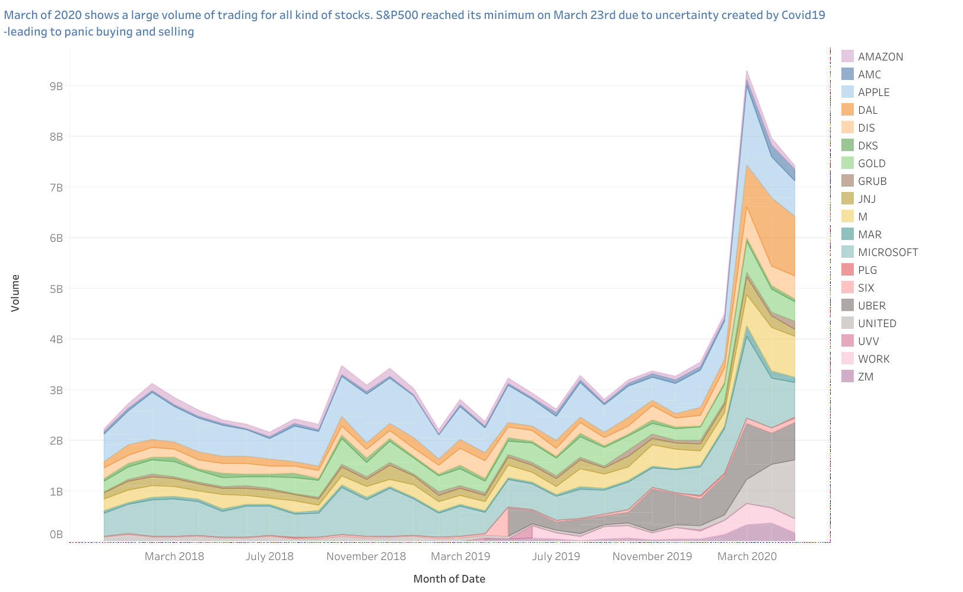
There had been a large volume of stocks traded in March of 2020. This deviation can be further studied by doing statistical analysis of the behaviour of past data.
Key Insights
Vlalue of S&P500 reached its lowest on March 23rd due to Covid19 uncertainty which could have led to panic trading.
Source: Southern Water Corp Statistical Records

Slide 5
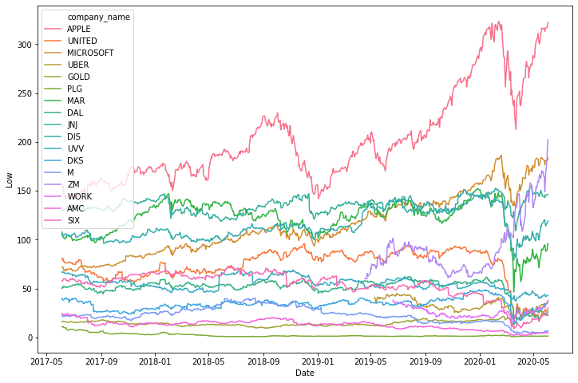
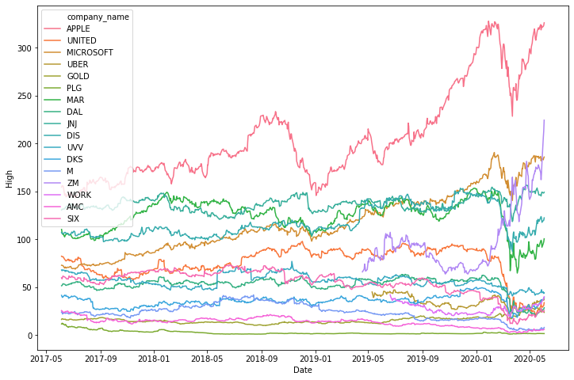
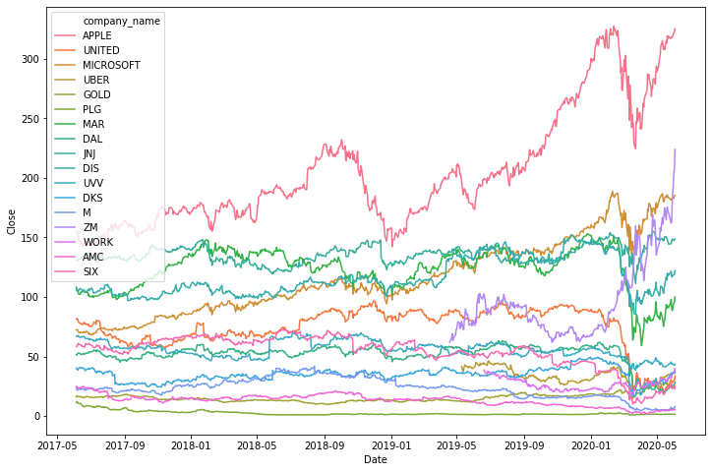
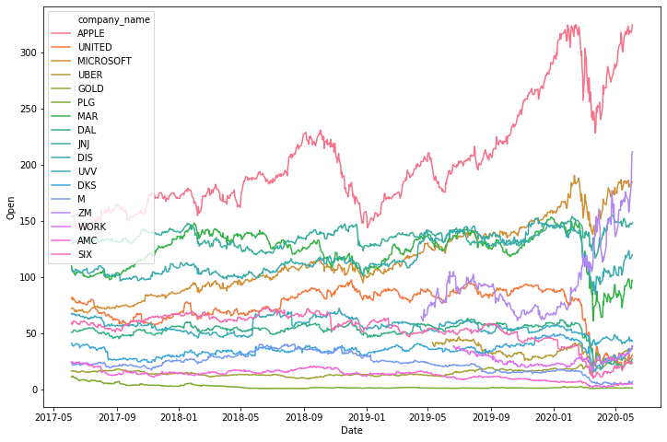
Analysis by doing a time plot of the HIGH, LOW, OPEN and CLOSE costs for last 3 years shows few stocks going up in price while mostly showing a fall in price

Slide 6
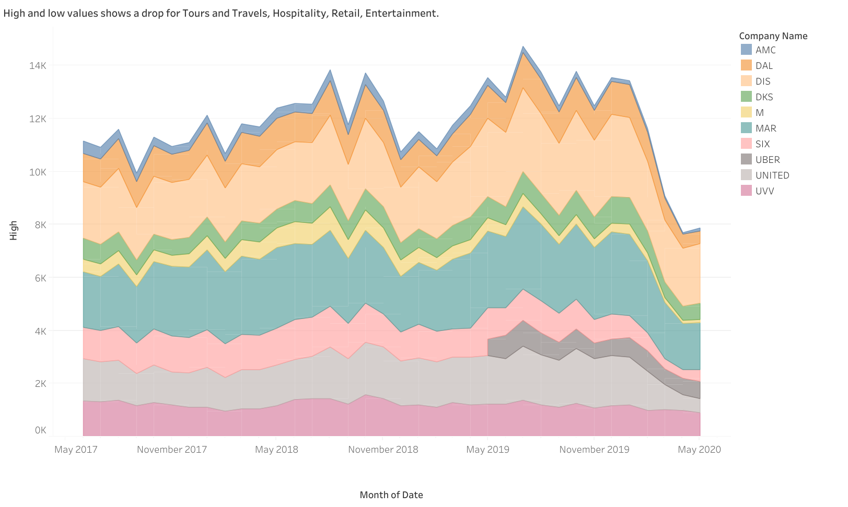
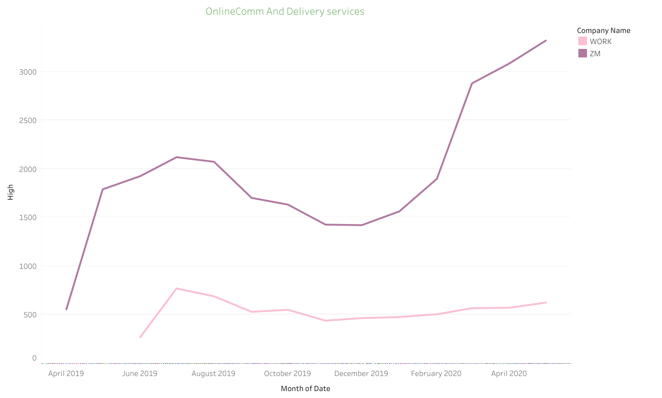
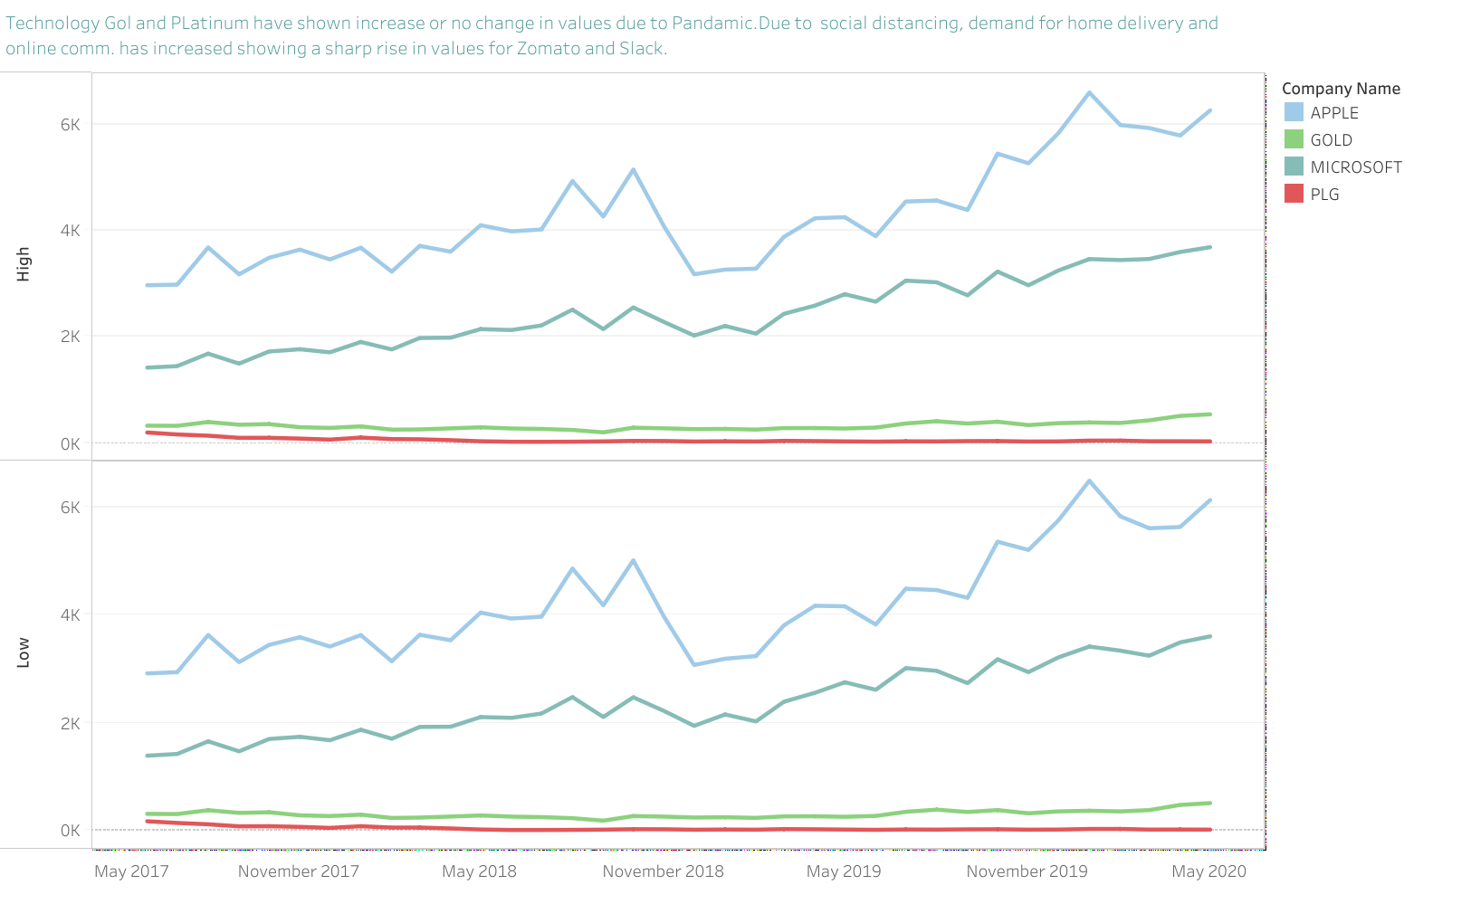
Further analysis of HIGH and LOW values of stocks from different sectors shows few stocks, like those from Technology going up while most of other belonging to entertainment, travel and hospitality has gone down in March
Key Insights
Covid numbers started flaring most in March and with social distancing in place most sectors had a loss resulting in fall of stock value.
Demands for certain sectors like home delivery and online communication increased causing there stock value to increase
Key Insights

Slide 7
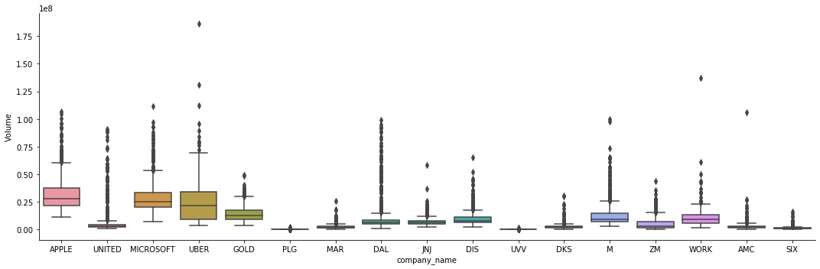
Box-plot Analysis of the stocks shows lots of outliers present for volume, specially in Airlines industries followed by tech and retail. Outliers are present in high and low values of prices of stocks present in travel , tech and retail.

Slide 8
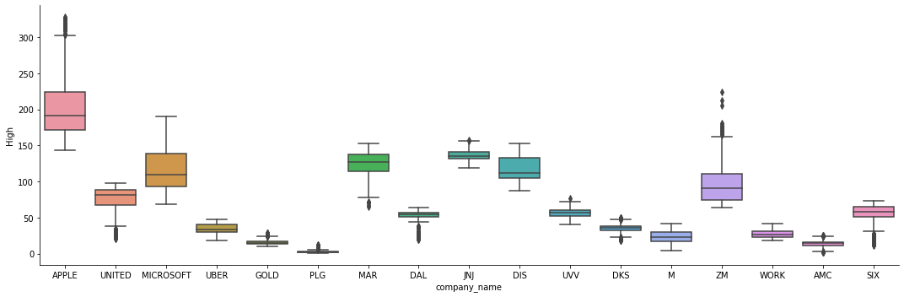
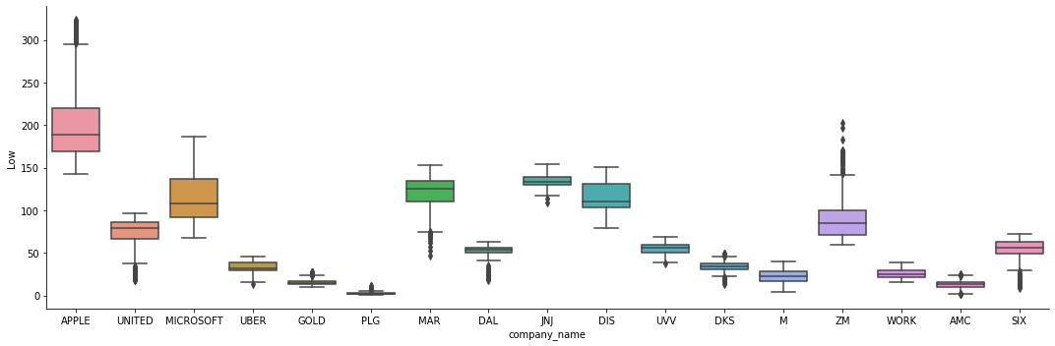
Boxplot analysis shows outliers present for high and low values for most negatively impacted industries( Airlines, retail) to most positively impacted industries (ZM. Slack) .

Slide 9
In Conclusion…
There has been a strong impact on businesses in all domains due to Covid.
Tours and Travels, mainly airlines industries along with entertainment and retail have been most negatively impacted.
Social distance have given rise to the demand of online communication and home delivery
causing a sharp increase in their value.
Covid19 had caused a big uncertainty causing S&P500 to fall to its lowest value causing panic trading in March 2020

